Slide 1
AMANORA PARK TOWN
R-29
AMANORA GOLD
PHASE 1 – T42 & T43
JUNE 2020

Slide 2
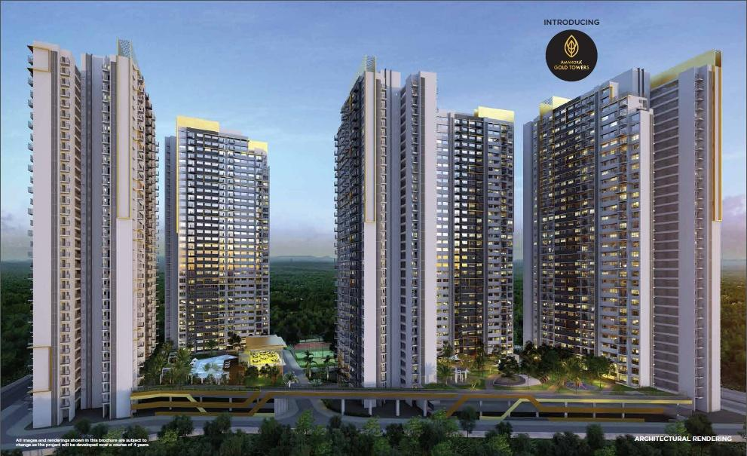
R-29 AMANORA GOLD TOWERS

Slide 3
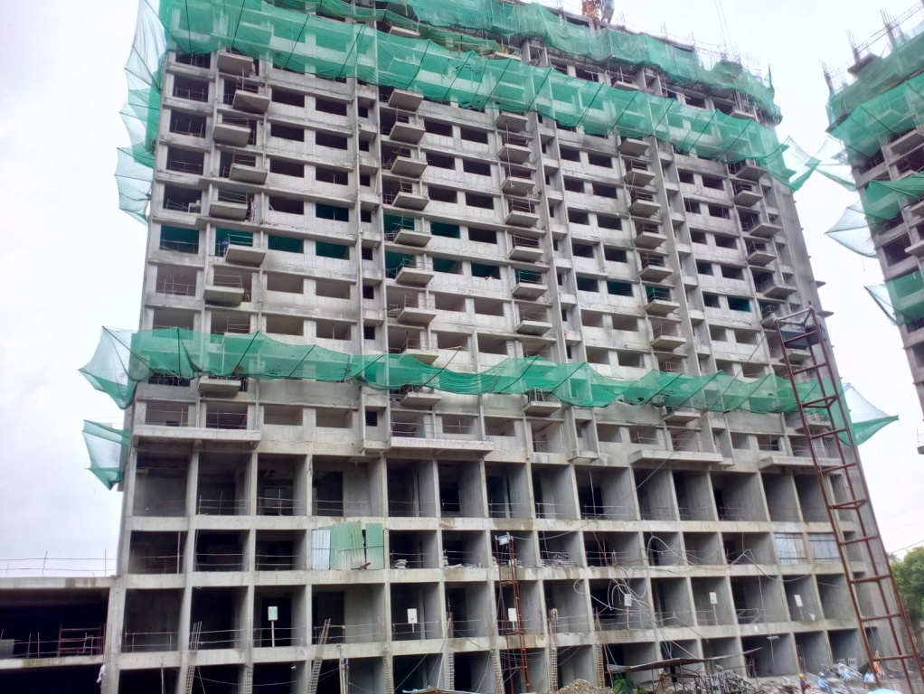
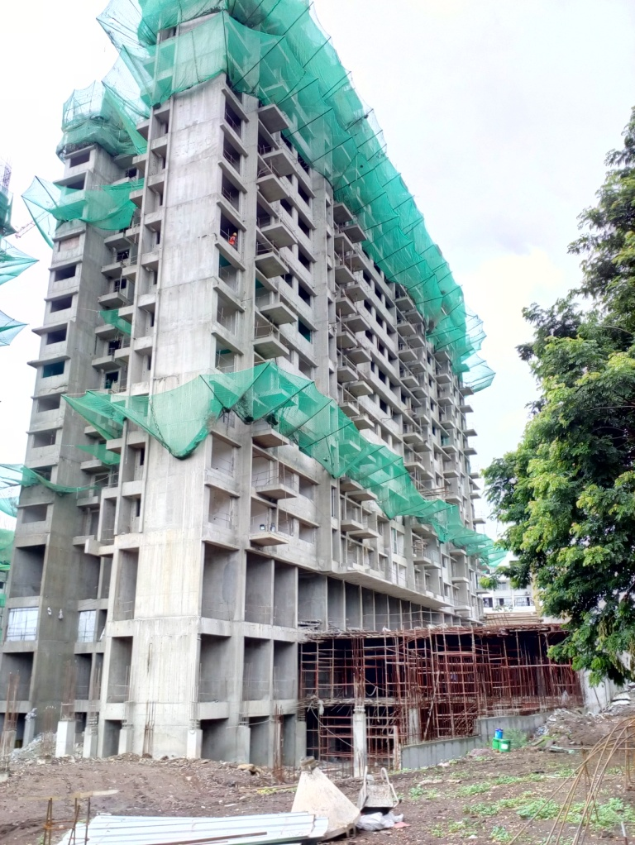
TOWER NO:- 042

Slide 4
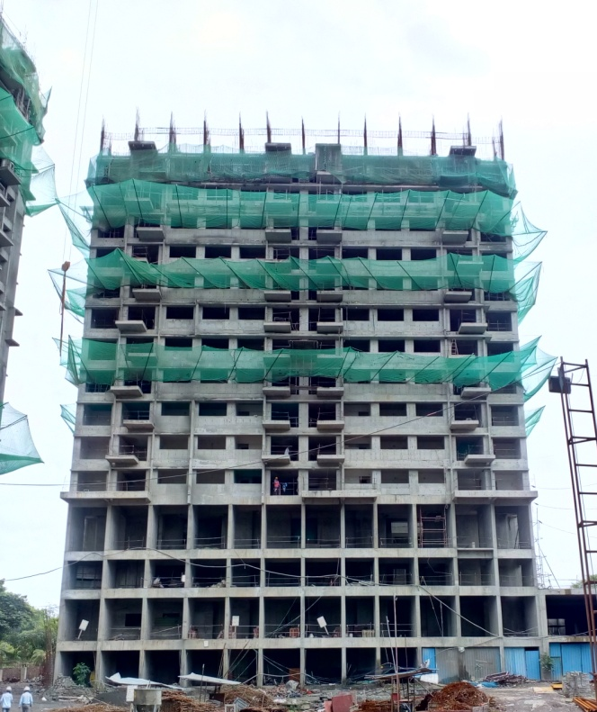
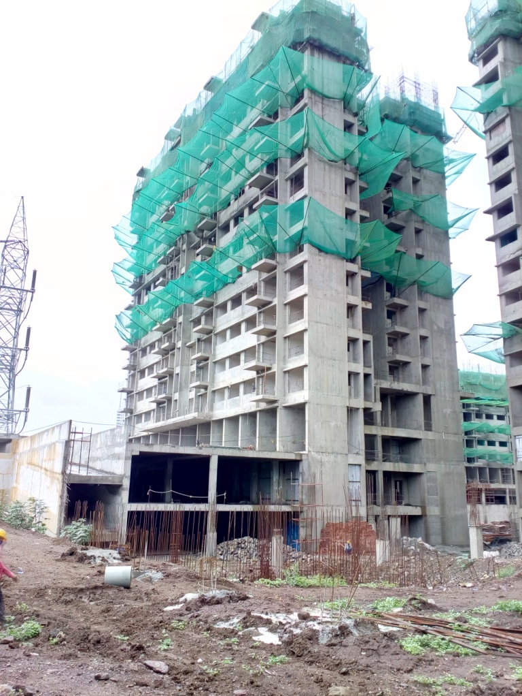
TOWER NO:- 043

Slide 5
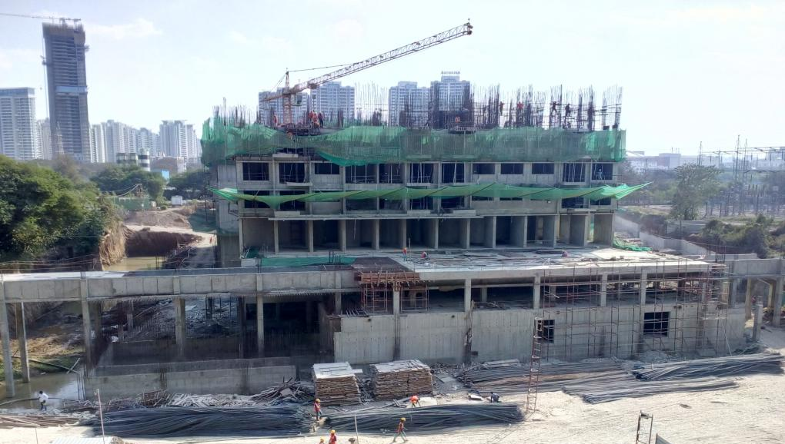
Under Ground water Tank :-

Slide 6
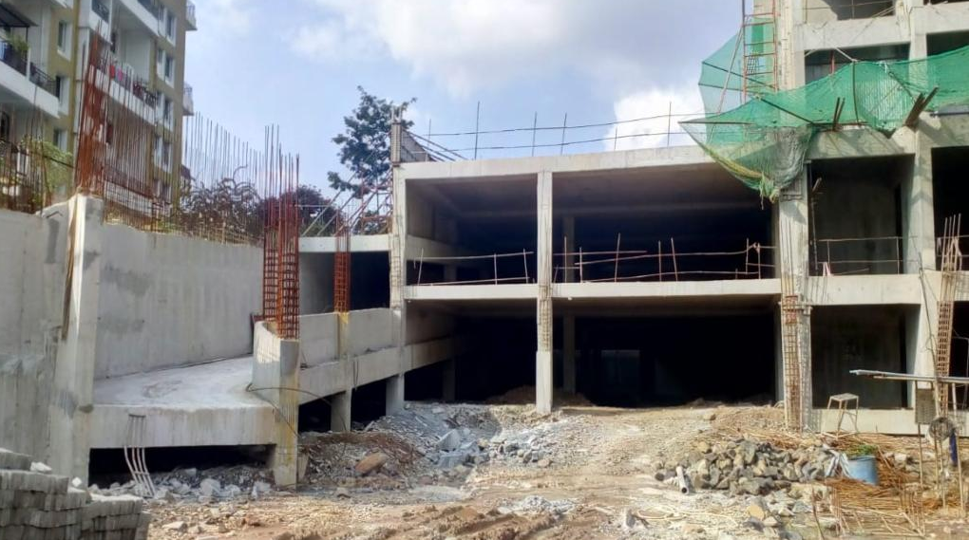
Podium Area- PA1 North-West Side:-

Slide 7
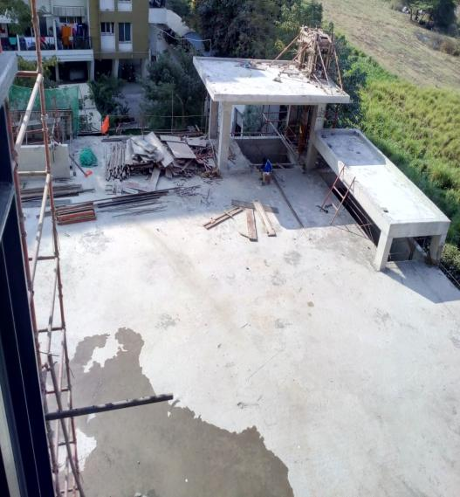
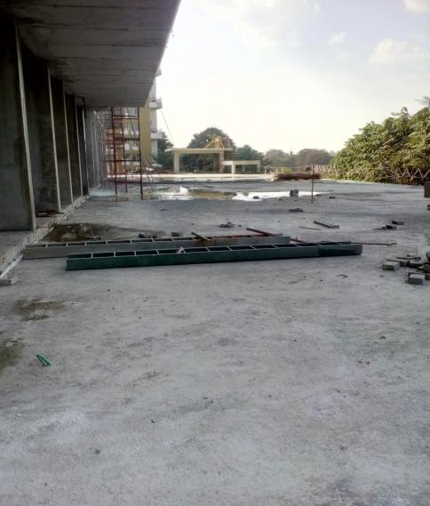
Podium Area- PA1 North-West Side:-

Slide 8
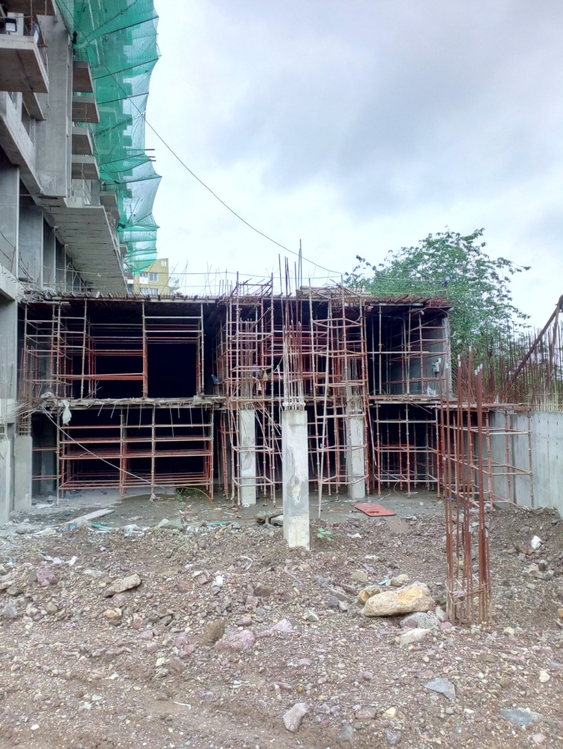
Podium- PA2 Area:-

Slide 9
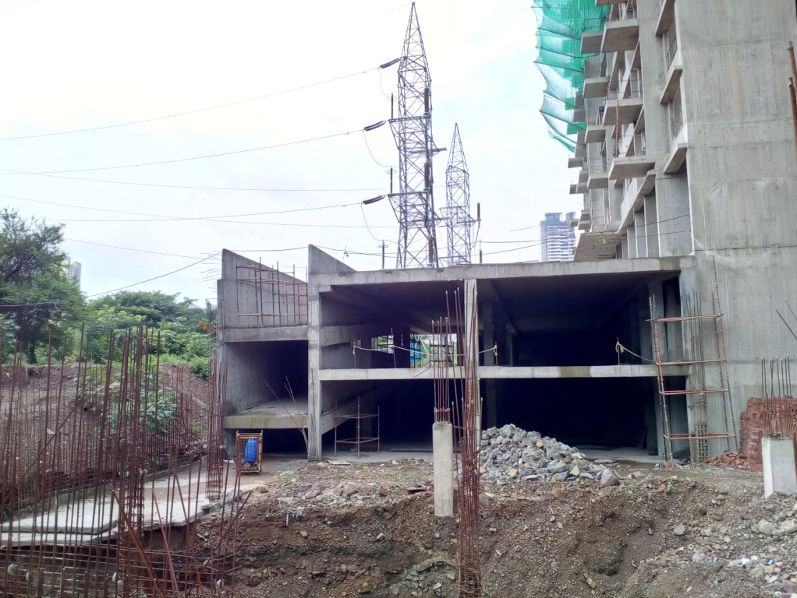
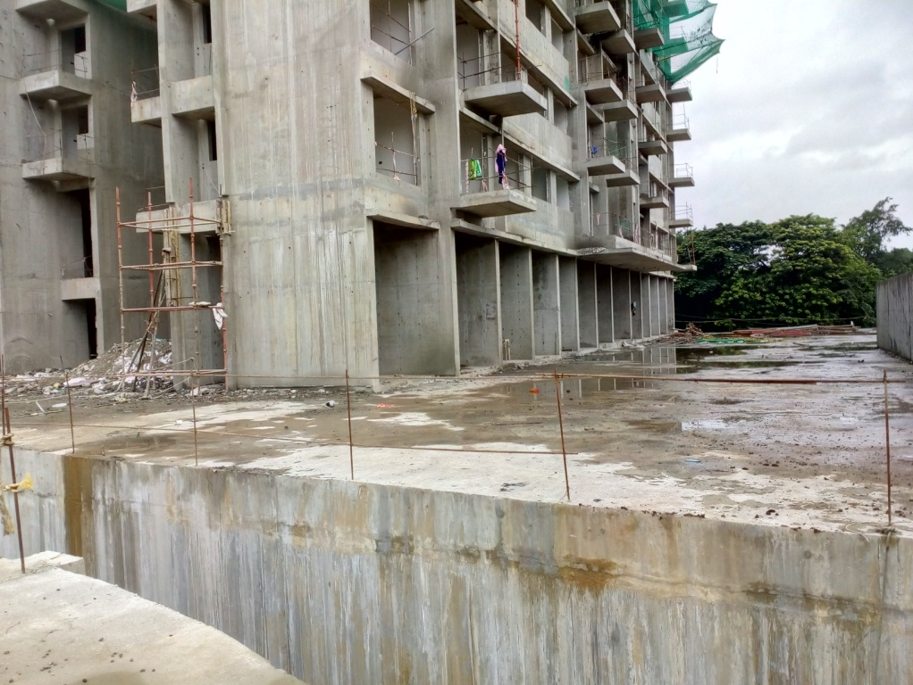
Podium- PA3 Area:-

Slide 10
THANK YOU !

